Slide 1
16.01.2025
Pascal

Slide 2
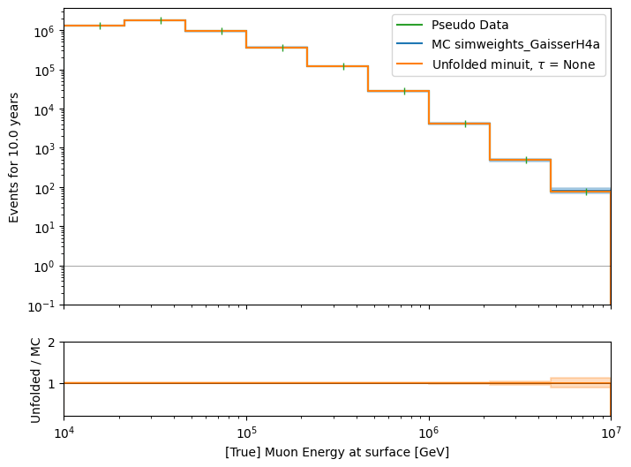
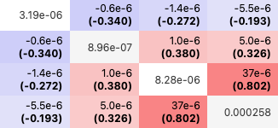

Fix unfolding bins, fit 4 systematics
X0 = [True values, 1, 1, 1, 0.2]
Scattering: 1.0198
Absorption: 1.0027
DOMEfficiency: 1.0054
HoleIce p0: 0.113
Hesse matrix

Slide 3
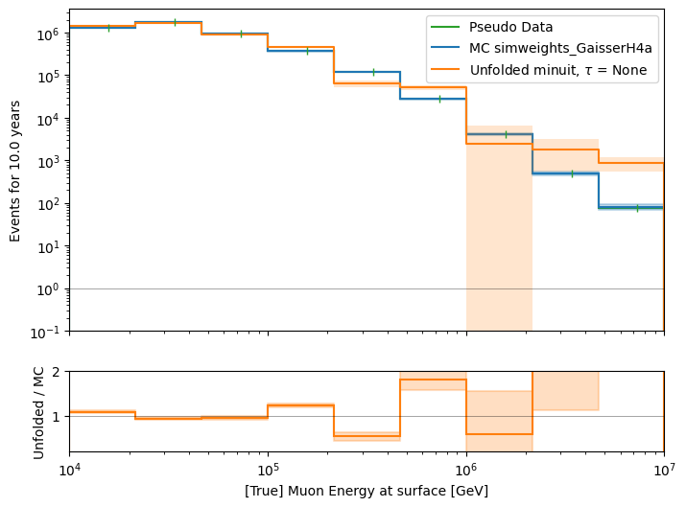
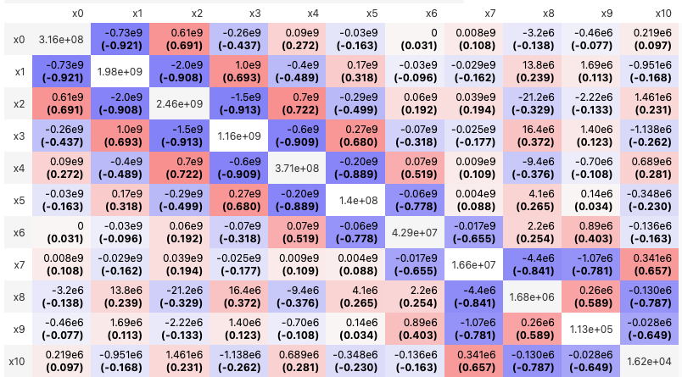

Fit unfolding bins, fix 4 systematics
X0 = [True values, Fit systematics]

Slide 4
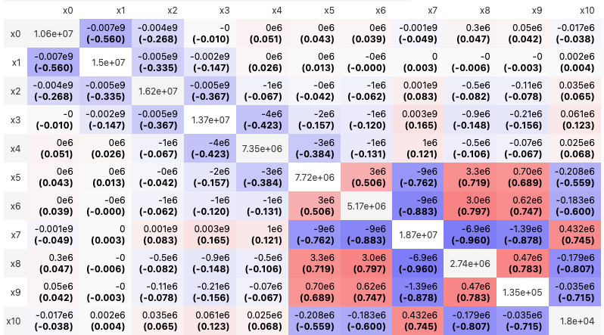
Running m.migrad() a second time
1 call
2 calls
- Actual fit values are basically the same

Slide 5
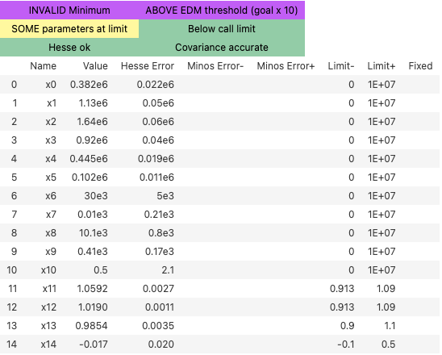
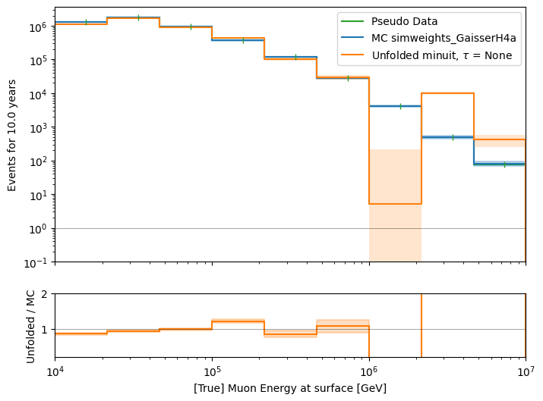
Fit all --> no overflow bounds
X0 = [True values, Fit systematics]
Overflow bin is at limit → add 2. overflow bin?

Slide 6
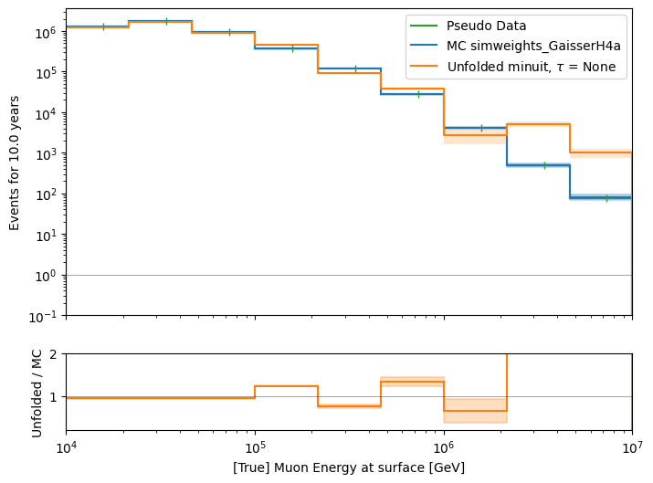
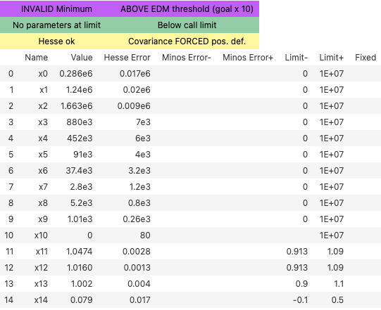
Fit all
X0 = [True values, Fit systematics]
improvement

